Slide 1

Neural Networks
Yong Peng

Slide 2
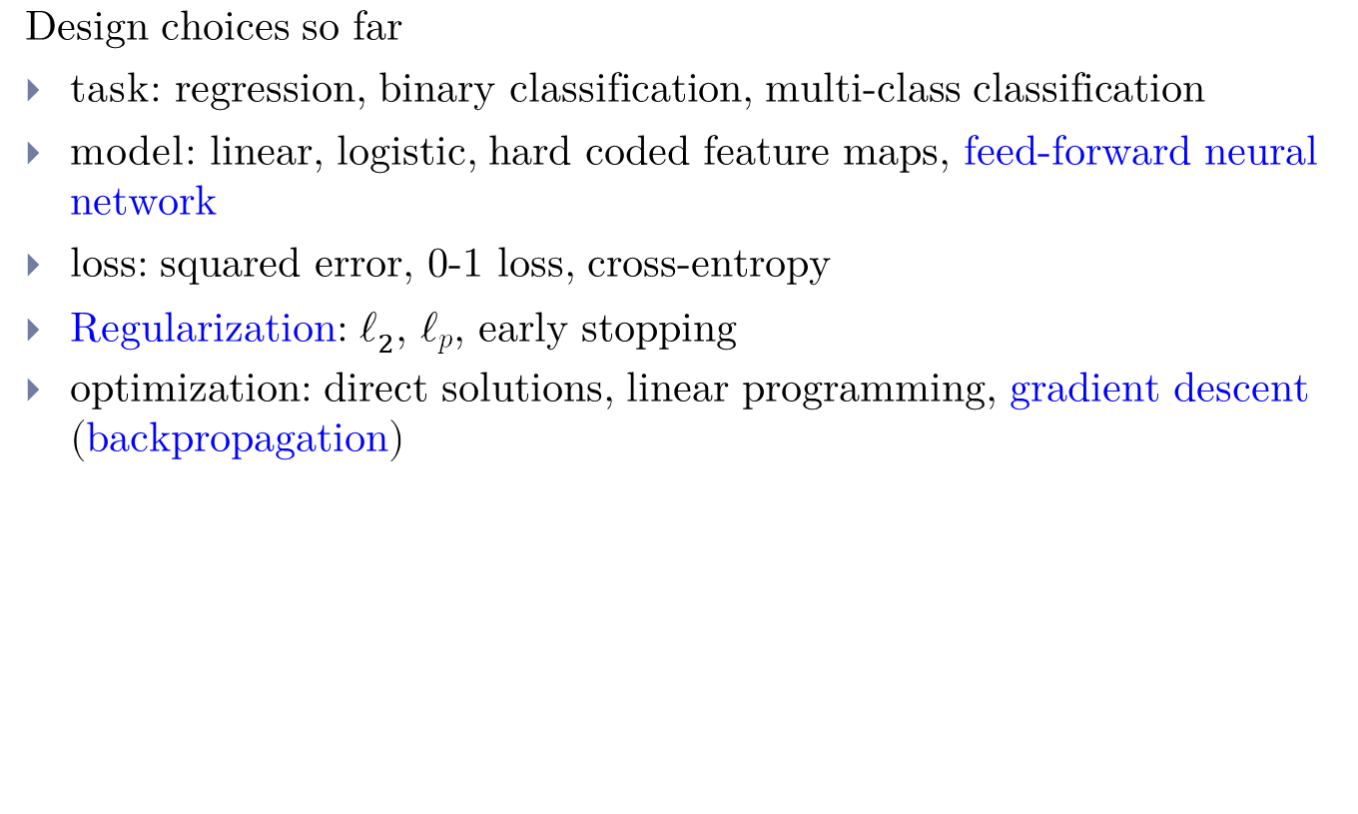
Overview
Design choices so far
task: regression, binary classification, multi-class classification
model: linear, logistic, hard coded feature maps, feed-forward neural network
loss: squared error, 0-1 loss, cross-entropy
Regularization: $ℓ_{2}$, $ℓ_{p}$, early stopping
optimization: direct solutions, linear programming, gradient descent (backpropagation)

Slide 3
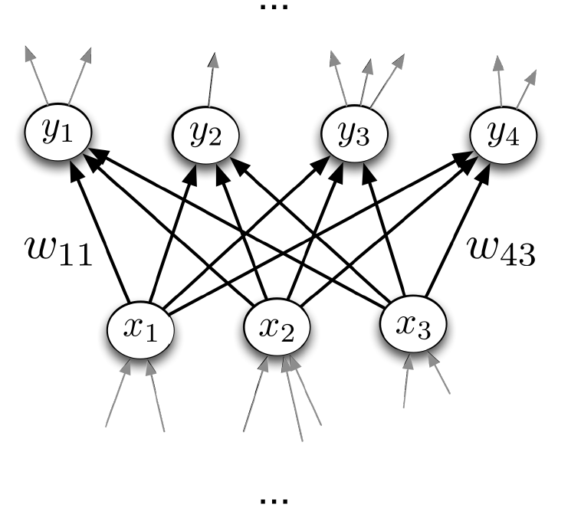






Neural Networks
Graphical show

Slide 4





Inspiration: The Brain
Neurons receive input signals and accumulate voltage. After some threshold they will fire spiking responses.
[Pic credit: www.moleculardevices.com]

Slide 5




Inspiration: The Brain
For neural nets, we use a much simpler model neuron, or unit:
Compare with logistic regression:
By throwing together lots of these incredibly simplistic neuron-like processing units, we can do some powerful computations!

Slide 6
Multilayer Perceptrons

Slide 7
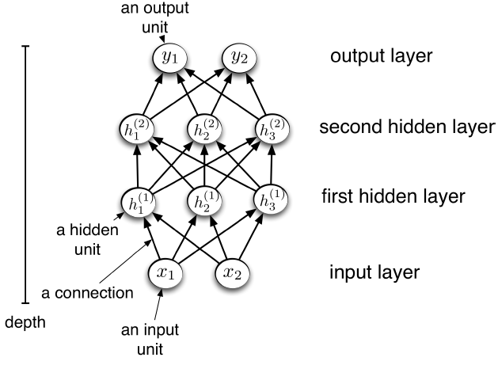
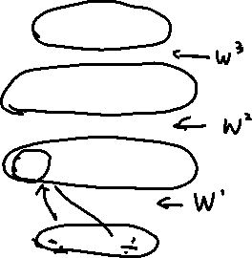


Multilayer Perceptrons
We can connect lots of units together into a directed acyclic graph.
Typically, units are grouped into layers.
This gives a feed-forward neural network.

Slide 8
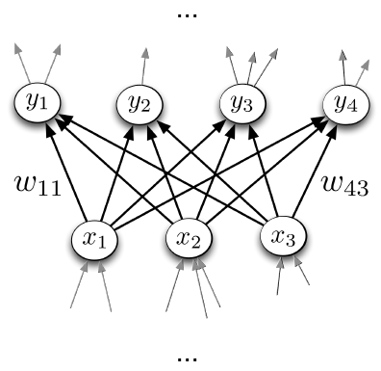
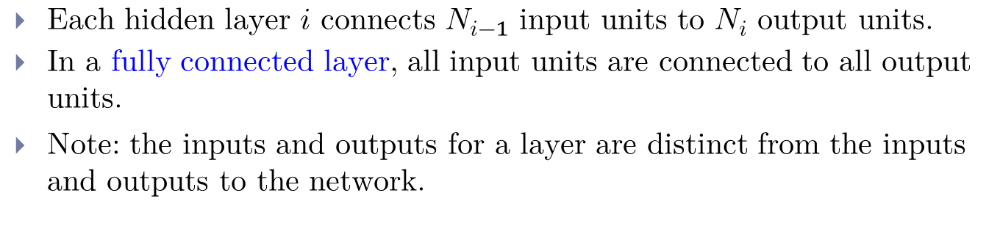

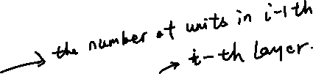
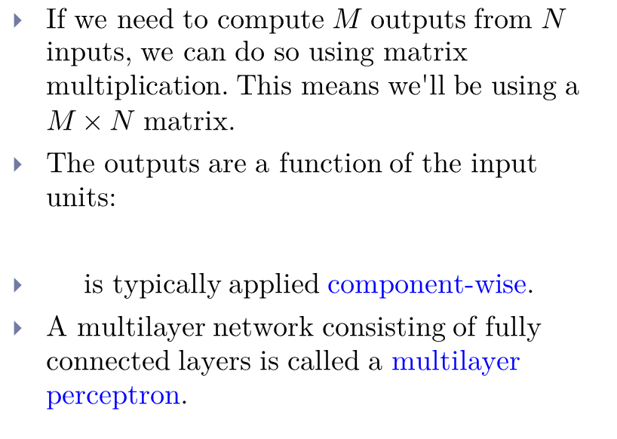
Multilayer Perceptrons
Each hidden layer $i$ connects $N_{i−1}$ input units to $N_{i}$ output units.
In a fully connected layer, all input units are connected to all output units.
Note: the inputs and outputs for a layer are distinct from the inputs and outputs to the network.
If we need to compute $M$ outputs from $N$ inputs, we can do so using matrix multiplication. This means we'll be using a $M×N$matrix.
The outputs are a function of the input units:
is typically applied component-wise.
A multilayer network consisting of fully connected layers is called a multilayer perceptron.

Slide 9
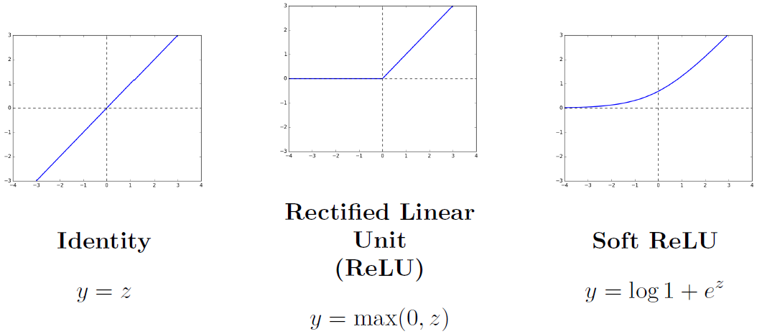




Multilayer Perceptrons
Some activation functions:

Slide 10
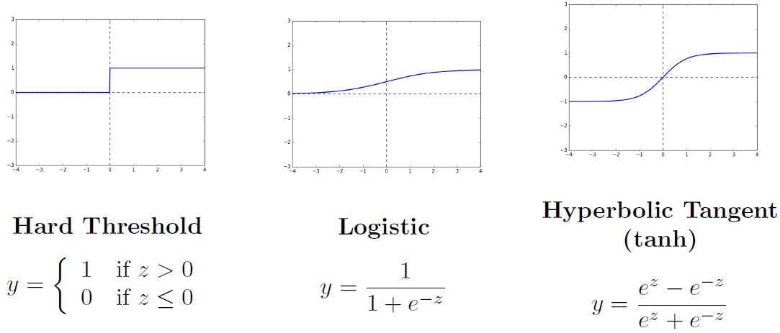



Multilayer Perceptrons
Some activation functions:

Slide 11
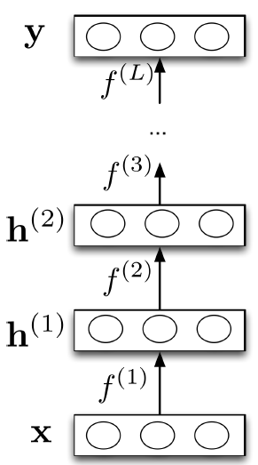
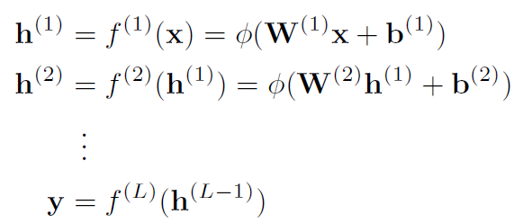





Multilayer Perceptrons
Each layer computes a function, so the network computes a composition of functions:
Or more simply:
Neural nets provide modularity: we can implement each layer's computations as a black box.

Slide 12





Feature Learning
Last layer:
If task is regression: choose
If task is binary classification: choose
So neural nets can be viewed as a way of learning features:

Slide 13

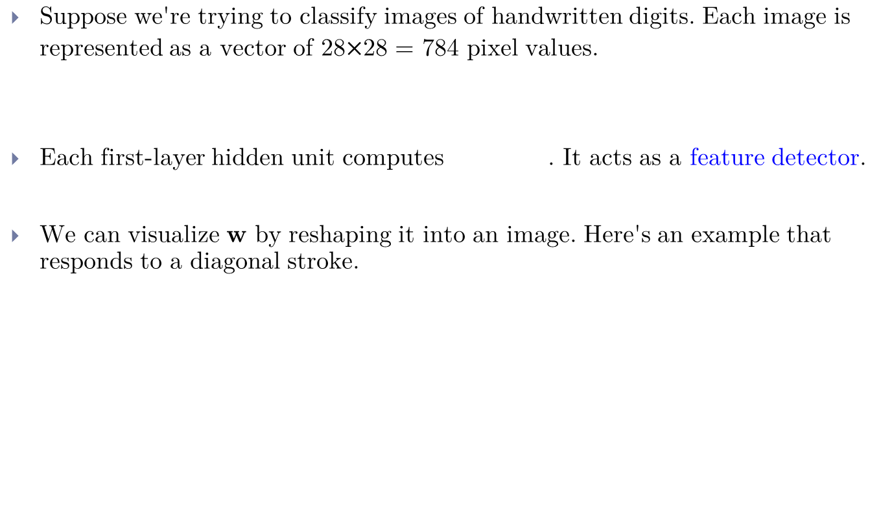
Feature Learning
Suppose we're trying to classify images of handwritten digits. Each image is represented as a vector of 28$×$28 = 784 pixel values.
Each first-layer hidden unit computes . It acts as a feature detector.
We can visualize $w$ by reshaping it into an image. Here's an example that responds to a diagonal stroke.

Slide 14

Feature Learning
Here are some of the features learned by the first hidden layer of a handwritten digit classifier:
Unlike hard-coded feature maps (e.g., in polynomial regression), features learned by neural networks adapt to patterns in the data.

Slide 15
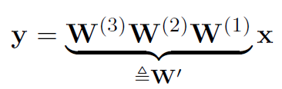

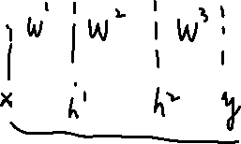
Expressivity-Linear Networks
Suppose a layer's activation function was the identity, so the layer just computes a affine transformation of the input
We call this a linear layer
Any sequence of linear layers can be equivalently represented with a single linear layer.
Deep linear networks can only represent linear functions.
Deep linear networks are no more expressive than linear regression.

Slide 16
Expressive Power-Non-linear Networks
Multilayer feed-forward neural nets with nonlinear activation functions are universal function approximators: they can approximate any function arbitrarily well, i.e., for any , there is a sequence with
This has been shown for various activation functions (thresholds, logistic, ReLU, etc.)
Even though ReLU is “almost” linear, it's nonlinear enough.

Slide 17
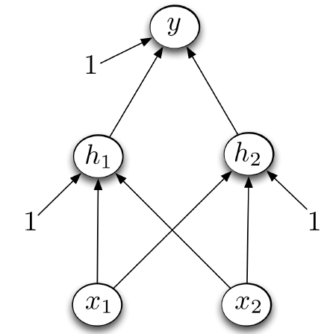

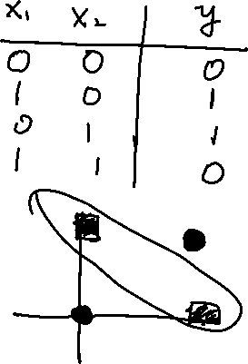



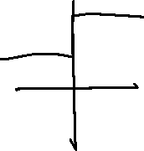
Multilayer Perceptrons
Designing a network to classify XOR (a nonlinear classification task):
Assume hard threshold activation function

Slide 18

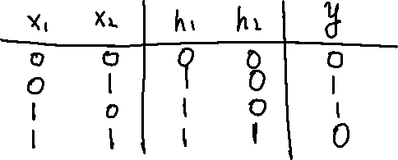




Multilayer Perceptrons
How it learns?
$h_{1}$ computes
i.e., $x_{1}$ OR $x_{2}$
$h_{2}$ computes
i.e., $x_{1}$ AND $x_{2}$
$y$ computes
i.e., $h_{1}$ AND (NOT $h_{2}$) = $x_{1}$ XOR $x_{2}$

Slide 19
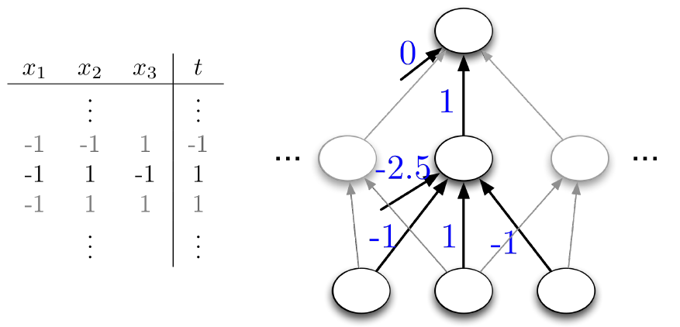


Expressivity
Universality for binary inputs and targets:
Hard threshold hidden units, linear output
Strategy: $2^{D}$ hidden units, each of which responds to one particular input configuration
Only requires one hidden layer, though it needs to be extremely wide.

Slide 20
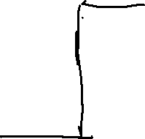
Expressivity
What about the logistic activation function?
You can approximate a hard threshold by scaling up the weights and biases:
This is good: logistic units are differentiable, so we can train them with gradient descent.

Slide 21
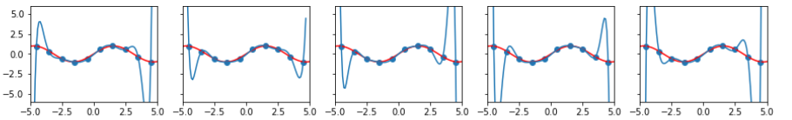

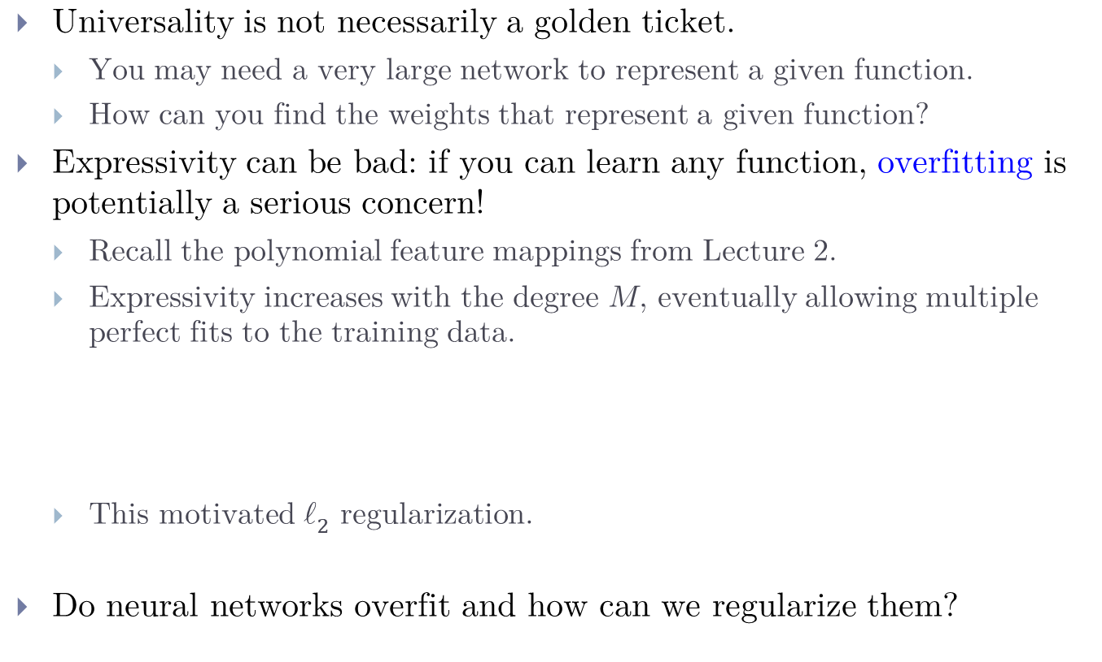
Expressivity: What is it good for?
Universality is not necessarily a golden ticket.
You may need a very large network to represent a given function.
How can you find the weights that represent a given function?
Expressivity can be bad: if you can learn any function, overfitting is potentially a serious concern!
Recall the polynomial feature mappings from Lecture 2.
Expressivity increases with the degree $M$, eventually allowing multiple perfect fits to the training data.
This motivated $ℓ_{2}$ regularization.
Do neural networks overfit and how can we regularize them?

Slide 22

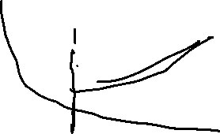
Regularization and Overfitting for Neural Networks
The topic of overfitting (when & how it happens, how to regularize, etc.) for neural networks is not well-understood, even by researchers!
In principle, you can always apply L2 regularization.
A common approach is early stopping, or stopping training early, because overfitting typically increases as training progresses.
Unlike $ℓ_{2}$ regularization, we don't add an explicit term to our cost.

Slide 23
Training neural networks with backpropagation

Slide 24


Training NN with backpropagation
Recall: gradient descent moves opposite the gradient (the direction of steepest descent)
Weight space for a multilayer neural net: one coordinate for each weight or bias of the network, in all the layers
Conceptually, not any different from what we've seen so far -- just higher dimensional and harder to visualize!
We want to define a loss and compute the gradient of the cost , which is the vector of partial derivatives.
This is the average of over all the training examples, so in this lecture we focus on computing .

Slide 25
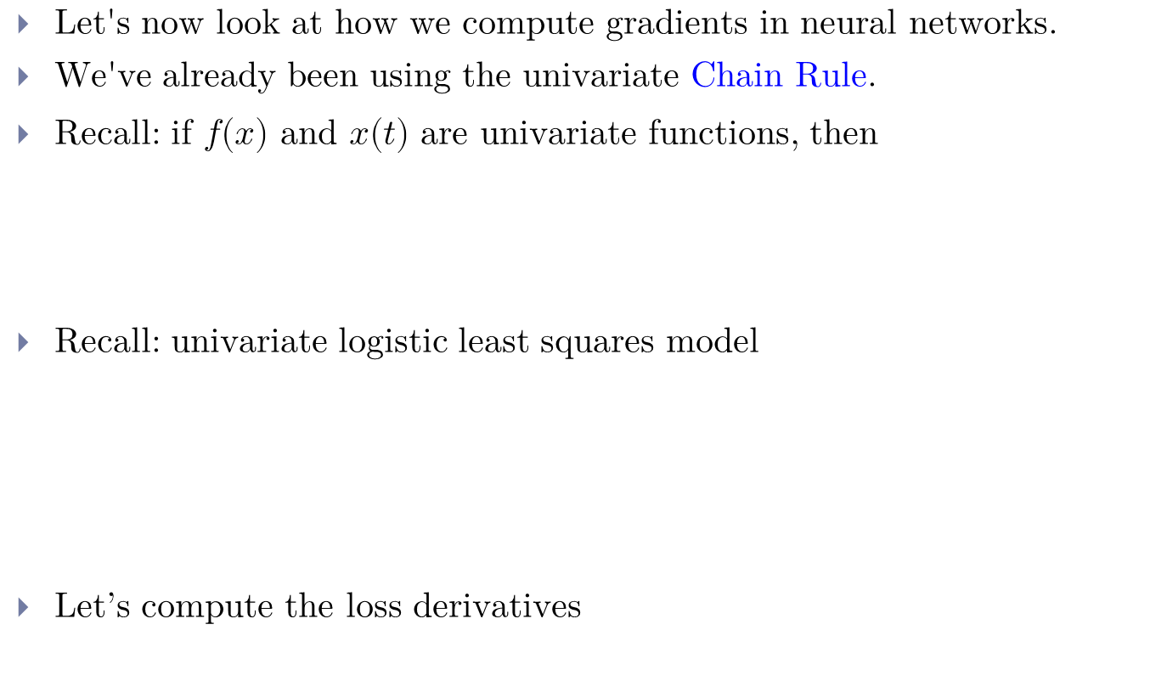

Univariate Chain Rule
Let's now look at how we compute gradients in neural networks.
We've already been using the univariate Chain Rule.
Recall: if $f(x)$ and $x(t)$ are univariate functions, then
Recall: univariate logistic least squares model
Let’s compute the loss derivatives

Slide 26
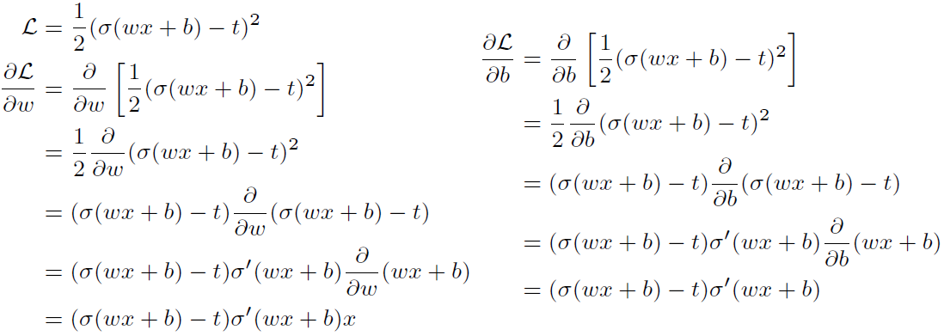

Univariate Chain Rule
How you would have done it in calculus class
What are the disadvantages of this approach?

Slide 27
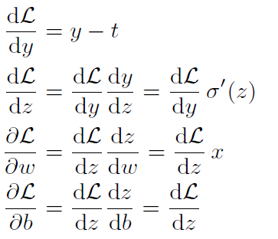
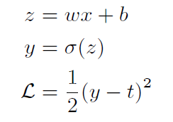

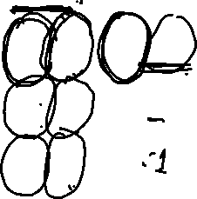
Univariate Chain Rule
A more structured way to do it
Remember, the goal isn't to obtain closed-form solutions, but to be able to write a program that efficiently computes the derivatives.
Computing the loss:
Computing the derivatives:

Slide 28
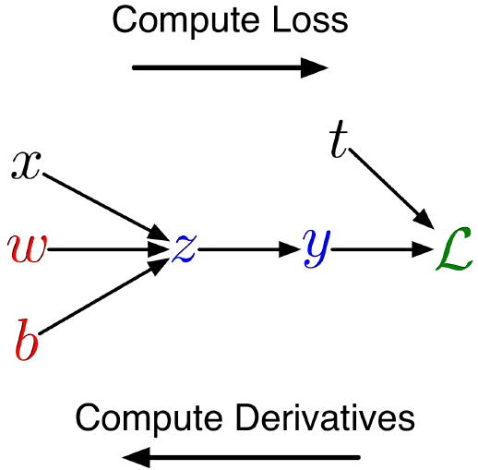
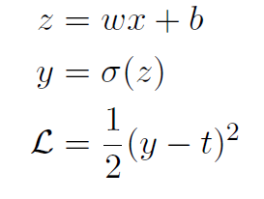


Univariate Chain Rule
We can diagram out the computations using a computation graph.
The nodes represent all the inputs and computed quantities, and the edges represent which nodes are computed directly as a function of which other nodes.
Computing the loss:

Slide 29
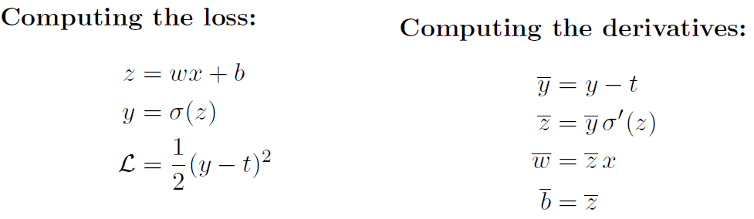



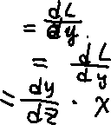
Univariate Chain Rule
A slightly more convenient notation:
Use to denote the derivative , sometimes called the error signal.
This emphasizes that the error signals are just values our program is computing (rather than a mathematical operation).

Slide 30
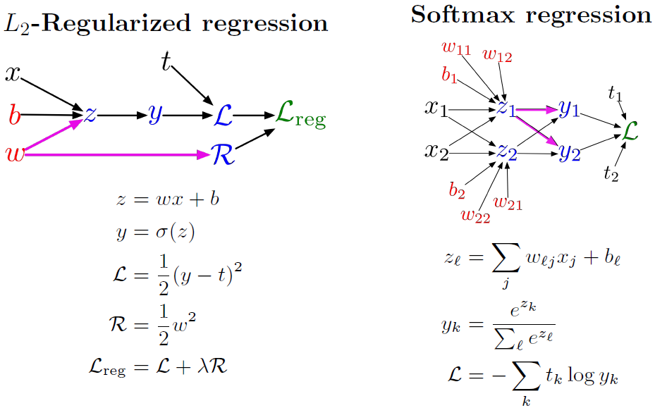






Multivariate Chain Rule
Problem: what if the computation graph has fan-out > 1?
This requires the Multivariate Chain Rule!

Slide 31
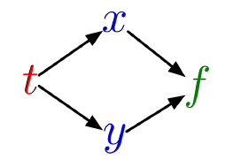





Multivariate Chain Rule
Suppose we have a function $f$($x$, $y$) and functions $x$($t$) and $y$($t$). (All the variables here are scalar-valued.) Then
Example:
Plug into the Chain Rule:

Slide 32
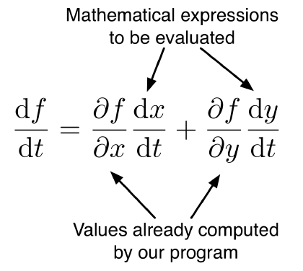
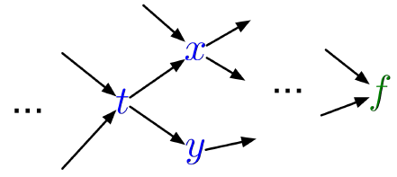

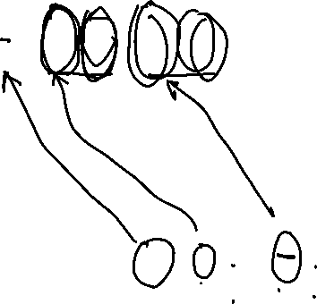

Multivariable Chain Rule
In the context of backpropagation:
In our notation:

Slide 33
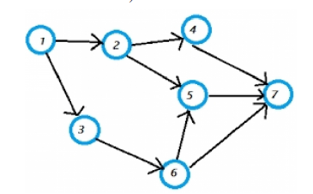
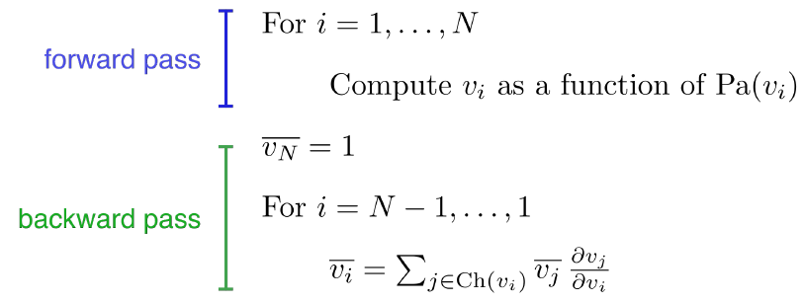







Backpropagation
Full backpropagation algorithm: Let $v_{1}$; $⋯$ ; $v_{N}$ be a topological ordering of the computation graph (i.e. Parents come before Children.)
$v_{N}$ denotes the variable we're trying to compute derivatives of (e.g. loss).

Slide 34
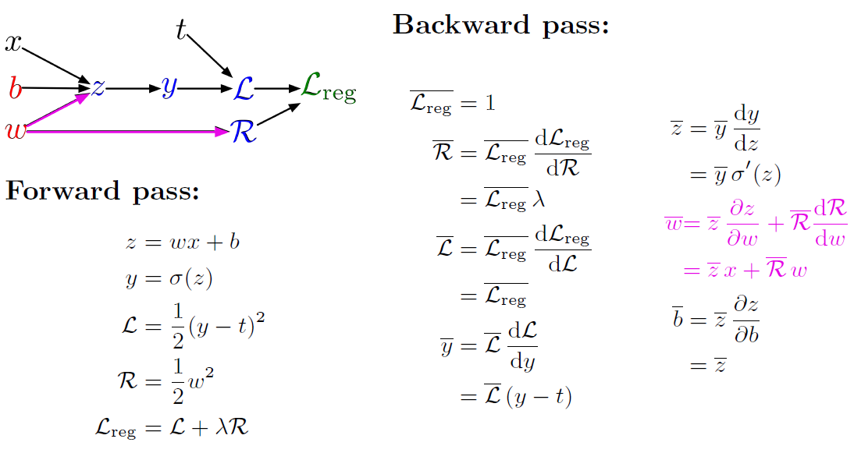
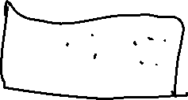




Backpropagation
Example: univariate logistic least squares regression

Slide 35
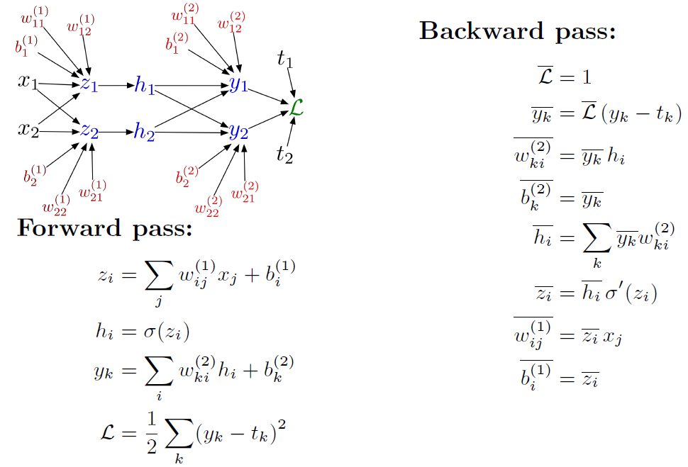












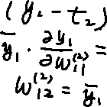

Backpropagation
Multilayer Perceptron (multiple outputs):

Slide 36
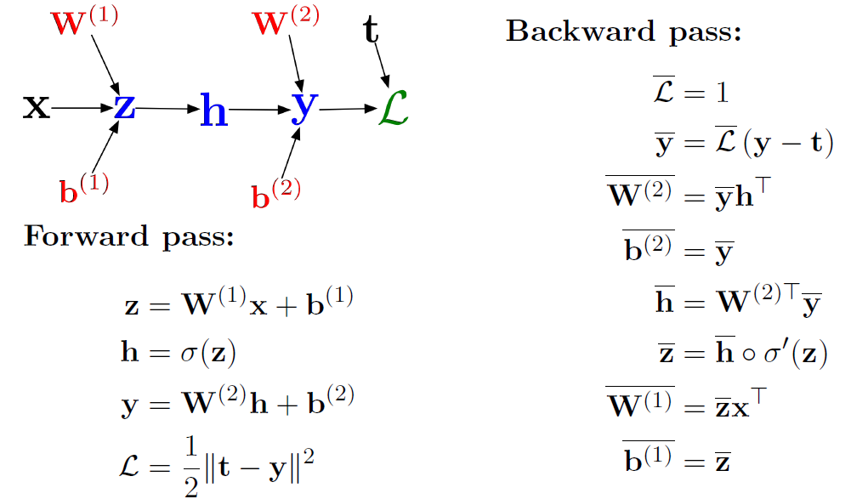







Backpropagation
In vectorized form:

Slide 37


Computational Cost
Computational cost of forward pass: one add-multiply operation per weight
Computational cost of backward pass: two add-multiply operations per weight
Rule of thumb: the backward pass is about as expensive as two forward passes.
For a multilayer perceptron, this means the cost is linear in the number of layers, quadratic in the number of units per layer.

Slide 38




Backpropagation
Backprop is the algorithm for efficiently computing gradients in neural nets.
Gradient descent with gradients computed via backprop is used to train the overwhelming majority of neural nets today.
Even optimization algorithms much fancier than gradient descent (e.g. second-order methods) use backprop to compute the gradients.
Despite its practical success, backprop is believed to be neutrally implausible.

Slide 39
Beyond Feed-forward Neural Networks (Optional)
For modern applications (vision, language, games) we use more complicated architectures.

